Slide 1

Ethics in Information Technology, Fifth Edition
Chapter 2
Ethics for IT Workers and IT Users

Slide 2
Recap
Computing and importance of IT
Domains of Computing (CS, SE, EE, CE, IT)
How IT reshaping businesses
Professionalism
Profession, Demand of professionalism
Characteristics of profession and professionals
Software Contract
Main sections of software contact
Types of software contract (Fixed Price, Cost Plus)

Slide 3
Recap (cont’d)
Outsourcing
On-Shore
Off-Shore
Near-Shore
Chapter 01: Basics of Ethics
Ethics vs Moral
Fostering Good Business Ethics
Corporate Ethics improvement
Ethical Decision Making
Types of Ethics Decisions

Slide 4
Objectives
As you read this chapter, consider the following questions:
Part - I
What key characteristics distinguish a professional from other kinds of workers, and is an IT worker considered a professional?
What factors are transforming the professional services industry?
What relationships must an IT worker manage, and what key ethical issues can arise in each?

Slide 5
Objectives (cont’d.)
Part - II
What relationships must an IT worker manage, and what key ethical issues can arise in each? (cont’d)
How do codes of ethics, professional organizations, certification, and licensing affect the ethical behavior of IT professionals?
Part - III
What is meant by compliance, and how does it help promote the right behaviors and discourage undesirable ones?

Slide 6
Ethics in Information Technology, Fifth Edition
Chapter 2
Ethics for IT Workers and IT Users
Lecture 1
Distinguish other workers and IT workers
Changing professional services industry
IT workers with Employer

Slide 7
IT Professionals
Profession is a calling that requires:
Specialized knowledge
Long and intensive academic preparation
Professionals:
Require advanced training and experience
Must exercise discretion and judgment in their work
Their work cannot be standardized
Contribute to society, participate in lifelong training, assist other professionals
Carry special rights and responsibilities
Notes:
Discretion: choice, option

Slide 8
Are IT Workers Professionals?
Partial list of IT specialists
Programmers (System software/application software)
Systems analysts
Software engineers
Database administrators
Local area network (LAN) administrators
Chief information officers (CIOs)
Web Developer/Administrator
Information Technology Specialist.

Slide 9
Are IT Workers Professionals? (cont’d.)
Legal perspective
IT workers do not meet legal definition of professional
Not licensed by state or federal government
Left on some associations
Not responsible for misconduct

Slide 10
The Changing Professional Services Industry
IT workers are considered part of the professional services industry
Seven forces are changing professional services
Client sophistication (able to drive hard bargains)
Governance (due to major scandals)
Connectivity (instant communications)
Transparency (view work-in-progress in real-time)
Modularization (able to outsource modules)
Globalization (worldwide sourcing)
Commoditization (for low-end services)

Slide 11
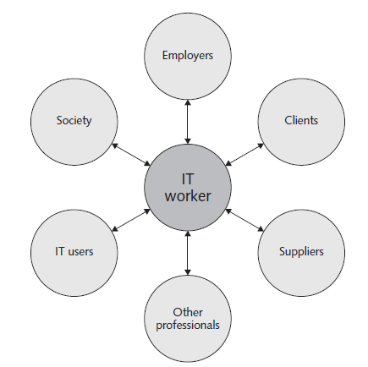
Professional Relationships That Must Be Managed
IT workers involved in relationships with:
Employers
Clients
Suppliers
Other professionals
IT users
Society at large

Slide 12
Relationships Between IT Workers and Employers
IT workers agree on many aspects of work relationship before workers accept job offer
Other aspects of work relationship defined in company’s policy and procedure manual or code of conduct
Some aspects develop over time
As steward of organization’s IT resources, IT workers must set an example and enforce policies regarding the ethical use of IT

Slide 13
Relationships Between IT Workers and Employers
Software piracy
Act of illegally making copies of software or enabling access to software to which they are not entitled
Area in which IT workers can be tempted to violate laws and policies
The Business Software Alliance (BSA) is a trade group representing the world’s largest software and hardware manufacturers; mission is to stop the unauthorized copying of software
Thousands of cases prosecuted each year

Slide 14
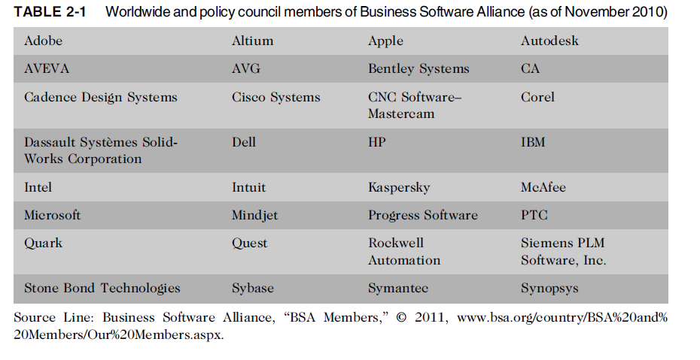
Relationships Between IT Workers and Employers (cont’d.)

Slide 15
Relationships Between IT Workers and Employers (cont’d.)
IT workers must set an example and enforce policies regarding the ethical use of IT in: (cont’d.)
Trade secrets
Business information generally unknown to public
Company takes actions to keep confidential
Require cost or effort to develop
Have some degree of uniqueness or novelty
Whistle-blowing
Employee attracts attention to a careless user, illegal, unethical, abusive, or dangerous act that threatens the public interest

